Slide 1
MRL CRG
Cleanaway Update
19 August 2021

Slide 2
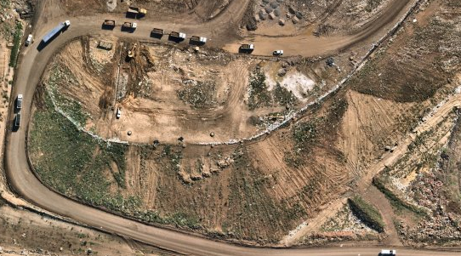
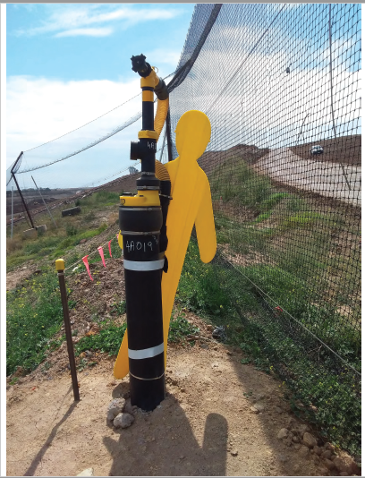
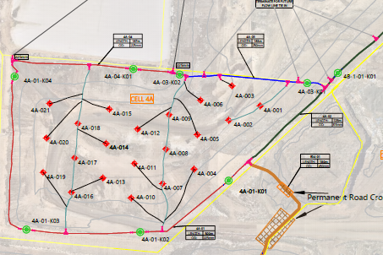
Environmental Compliance Update
Landfill Gas Collection Update
The installation of gas field infrastructure in 4A and header line extension completed in Jan 2021.
21 vertical extraction wells have been installed in Cell 4A to mitigate gas control on site.
Gas sent to biogas plant engines and flares.

Slide 3
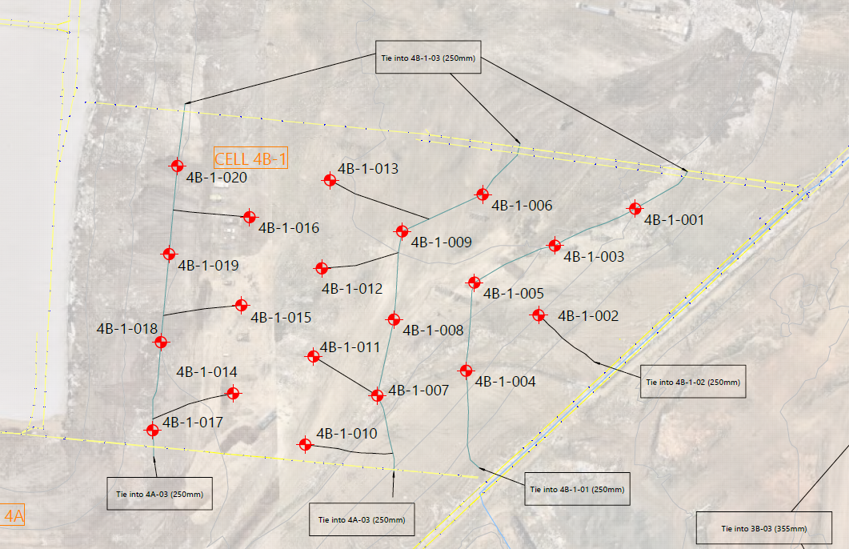
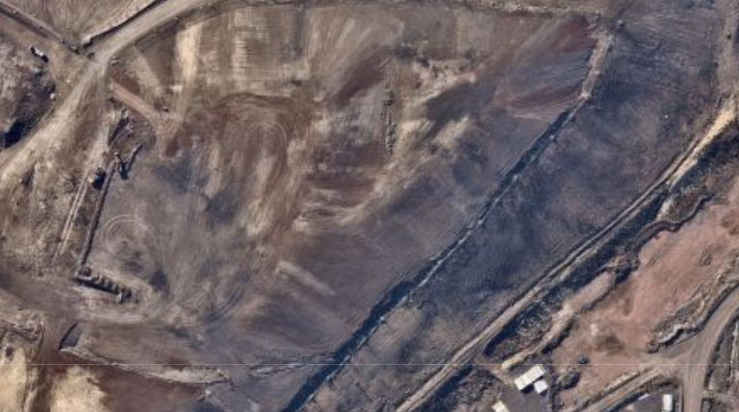
Environmental Compliance Update
Landfill Gas Collection Update
Planned gas extraction well works in stage 4 - 4B1
Proposed extraction wells to be adjacent to wells in 4A
Header line extension planned to allow for future tie into horizontal wells in 4C
Currently in design discussion phase – header line path with changing conditions of an operational site
Works to planned to commence in 2021
Rectification works of offline LFG wells in Stage 1 and 2 to commence August/September 2021.

Slide 4
Operations Update
Gas Plant Expansion
Install 8 new landfill gas generator modules
Double power generating capacity to 68,600MWh of electricity per year
Mitigate over 220,000 tonnes of greenhouse gas emissions per year
Approvals: Works Approval Granted

Slide 5
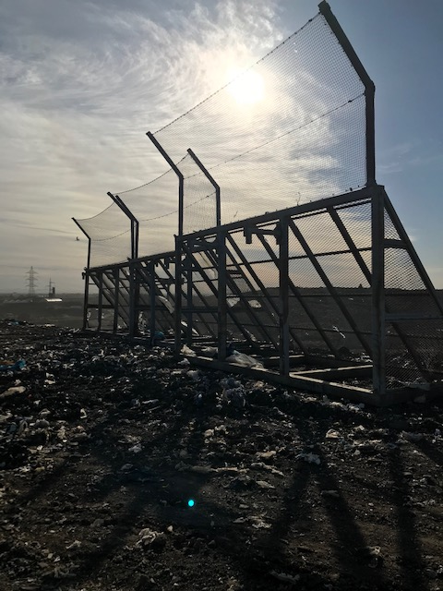
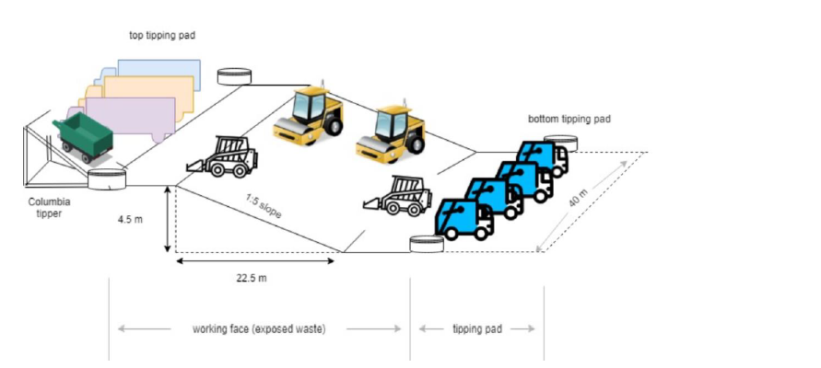
Operations Update
Working Face Management and Odour Management
Safety, Odour, Litter & Vermin
Waste Compaction - life of landfill, odour reduction, settlement and stability
Technology - (Visionlink and Propeller) – Field planning, compaction, Face size
Weekly in-house drone fly overs
Daily odour inspections (perimeter and site)
Face measurements - using handheld GPS and drone
WF Management Plan in place - Live document
Odour curtain – Northern nets 4C-1 & 4C-2

Slide 6
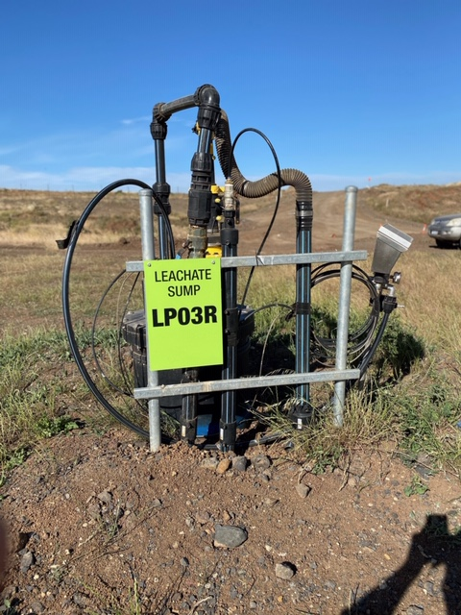
Leachate Redrills in Stage 2 and Pump Trial
Current status:
The 13 re drill were installed with both leachate and gas extraction (dual) –July/Aug 2020.
Gas extraction to maintain environmental control.
Leachate in stage 2 continues to be drawn down, however, “equilibrium” has been reached.
A pump trial to be conducted using a different type of pump – trial will conclude in the next month and report/findings will be Auditor reviewed before submitted to EPA.

Slide 7
EPA Approvals – A Better Environmental Outcome
Tarpomatic – Cleanaway gained approval from the EPA for a 12-month trial.
WGT Rock Re - Use Application – Cleanaway have submitted an application to crush and screen the WGT Rock and re-use it on lined areas of site. Safety concerns with landfilling large boulders.

Slide 8
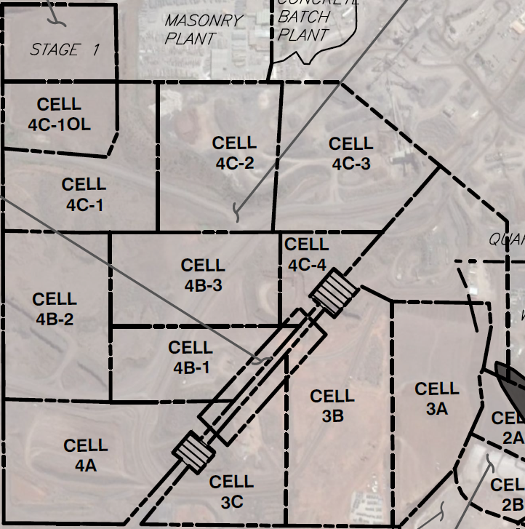
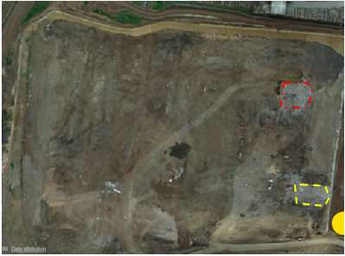
Landfill Fill Plan Update
Stage 4 Currently filling in 4C2
Whilst Licenced cells are 4A, 4B1, 4B2, 4B3 and 4C1 this does not imply the operational area is spanning across the entire Stage 4 area.
At any given day, a single operating face (maximum of two faces during peak times) is open within a dedicated area until the waste height has reached design level, then onto the next block and so on.

Slide 9
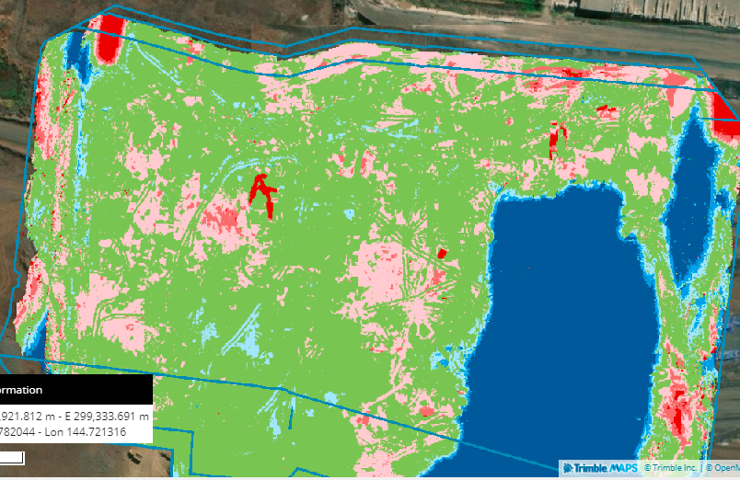
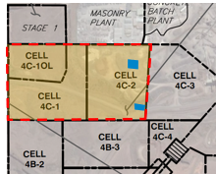
Vision Link
Lift 4 150,000m3 remaining
Ramp is being built along eastern boundary

Slide 10
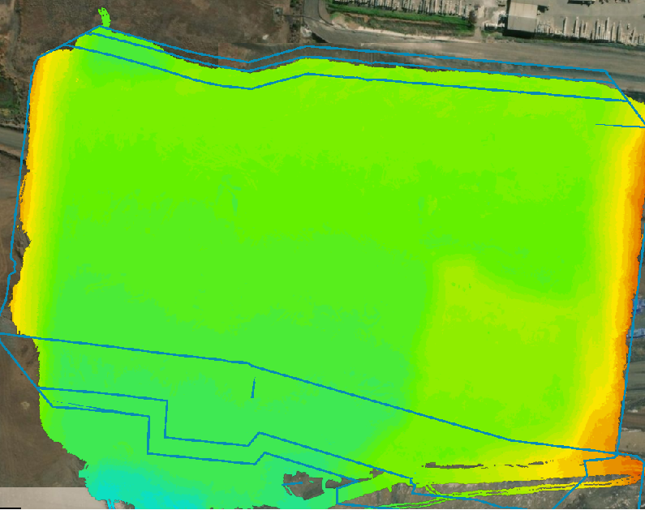
Landfill Fill Plan Update
Fill progression – Lift 5 has begun in 4C1 and Lift 4 closing out in Cell 4C2
Elevation (AHD)

Slide 11
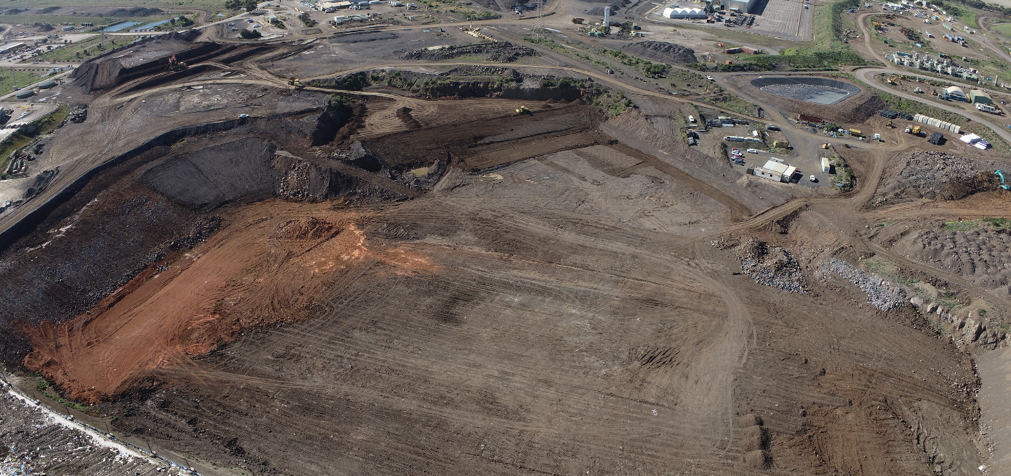
Construction Update
Current cells under Construction – Cell 4C3
Cell 4C3 expected to be Licenced in April

Slide 12
Cell Status and PC Dates (4C3)
Percentage complete:
Boral Bulk Out: 100% complete
Subgrade works: 80% complete
Compacted Clay Liner: 0%
GCL/Geomembrane: 0%
Geotextile Cushion: 0%
Leachate Drainage 0%
Geotextile Filter: 0%
Key Milestones / Items | Cell 4C3
Practical Completion Date | 28-Feb-22
Inclement Weather Allowance | 4 weeks
Auditor Sign-off | 30-Mar-22
EPA Approval | 11-May-22
Airspace reached by: | 01-Sept-22
Airspace Buffer (relative to 4C2) | 3.5 months
15-Aug-21

Slide 13
Proposed Leachate Pond
New leachate pond construction is pending EPA Works Approval, Planning Permit Application and VCAT hearing late 2021. Pond construction expected to commence July 2022
PROPOSED LOCATION FOR
NEW LEACHATE POND

Slide 14
Landfill Remediation Update
Rehabilitation Plan
Detail design has been approved by EPA Environmental Auditor
Design pending EPA final approval which is expected in September
Early works have commenced in undertaking subgrade trimming
Contractor has been selected and is due to commence construction 4th October
Program is 200 days long planned to finish in June

Slide 15
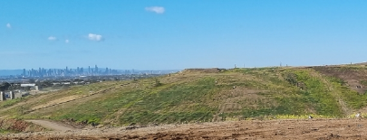
Cap Status and PC Dates
Percentage complete:
REA Submitted and Approved
Preferred supplier chosen
Subgrade works: 25%
GCL/Geomembrane: 0%
Geotextile Cushion: 0%
Subsoil:0%
Topsoil: 0%
Key Milestones / Items | Stage 2 Cap
Practical Completion Date | TBC
Inclement Weather Allowance | TBC
Auditor Sign-off | TBC
EPA Approval | TBC
REA approved amount | $9.9 million
FY22 Spend | $6.7 Million

